Slide 1
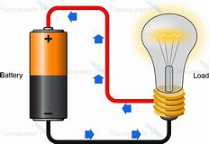
Electronics
Current
Practice Problems
LabRat Scientific
© 2018

Slide 2
If the light bulb has a resistance of 300 Ohms and its connected to a 28 V battery, what is the current running through the circuit?
V = IR
V 28 V
I = ------ = -------------- = 0.093 Amps
R 300 Ohms

Slide 3
In the circuit below, what is the resistance of the motor if the battery supplies 12 volts and the meter reads 0.5 Amps?
S
+
Disconnect here
M
V = IR
V 12 V
R = ------ = ------------- = 24 Ohms
I 0.5 Amps

Slide 4
What is the current running though the circuit shown below?
First, it is necessary to determine the total resistance in the circuit. For help, review the LabRat module on RESISTANCE.
R_{total} = 1,000 Ohms + 2,000 Ohms = 3,000 Ohms
V = IR
V 6.0 V
I = ------ = ---------------- = 0.002 Amps
R 3000 Ohms
1,000 Ohms
2,000 Ohms
+
6.0 Volts

Slide 5
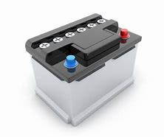
What is the current running though a 0.1 Ohm wire connected directly to the terminals of a 12V car battery? What do you think will happen to the wire?
V = IR
V 12 V
I = ------ = -------------- = 120 Amps
R 0.1 Ohms
A car battery would not have any problem supplying this much current. The wire will get very hot, very quickly, and will break – possibly bursting into flames in the process.
DO NOT TRY THIS!
12 V
0.1 Ohm

